Slide 1

Lakefront Half-Marathon 2026
Race Preparation and Goal-Setting Plan
Race Date
Start Time
November 1, 2026
7:30 AM · Grant Park
Goal Time
Bib Number
1:42:00
4417 · Corral B
Calvin Maxwell Roth · Lakefront Pacers, Chicago

Slide 2
Training Volume by Week
Miles logged per training week — January to February 2026
Peak Week
46.5 mi
Best Tempo
7:32 /mi
Long PR
13.1 mi

Slide 3
Target Race-Day Split Plan
Goal finish: 1:42:00 · Average pace 7:47 per mile
Segment | Target Pace | Cumul. Time | Notes
Mile 1 | 8:05 / mi | 0:08:05 | Conservative start, let crowd settle
Miles 2-4 | 7:55 / mi | 0:31:50 | Settle into rhythm, stay comfortable
Miles 5-7 | 7:47 / mi | 0:55:10 | Lock in goal pace, monitor effort
Miles 8-10 | 7:45 / mi | 1:18:25 | Hold form, fuel at mile 8
Miles 11-12 | 7:40 / mi | 1:33:45 | Push on strong legs
Mile 13.1 | 7:35 / mi | 1:42:00 | Empty the tank at the finish

Slide 4
Race Week Schedule · October 26 – November 1, 2026
Mon Oct 26
Full rest
No running. Final case prep wrap-up before trial window.
Tue Oct 27
Easy shakeout — 4 miles
Very light run, no intensity. Gear check for race day.
Wed Oct 28
Rest
Yoga and stretching only. Hydrate well.
Thu Oct 29
Strides — 3 miles
Easy 3 miles with 4×20-second strides to keep legs fresh.
Fri Oct 30
Rest + packet pickup
Grant Park expo for bib 4417. Lay out race-day kit.
Sat Nov 1
RACE DAY — 7:30 AM
Grant Park, Corral B. Goal: 1:42:00. Bib 4417.

Slide 5

Long Run Pace Progression
Average pace per mile across long runs — trending toward goal pace of 7:47 / mi
Key Insight
Best long run: 7:57 / mi
over 12.5 miles
Gap to goal: only 10 sec/mi
Lakefront Trail, Chicago

Slide 6
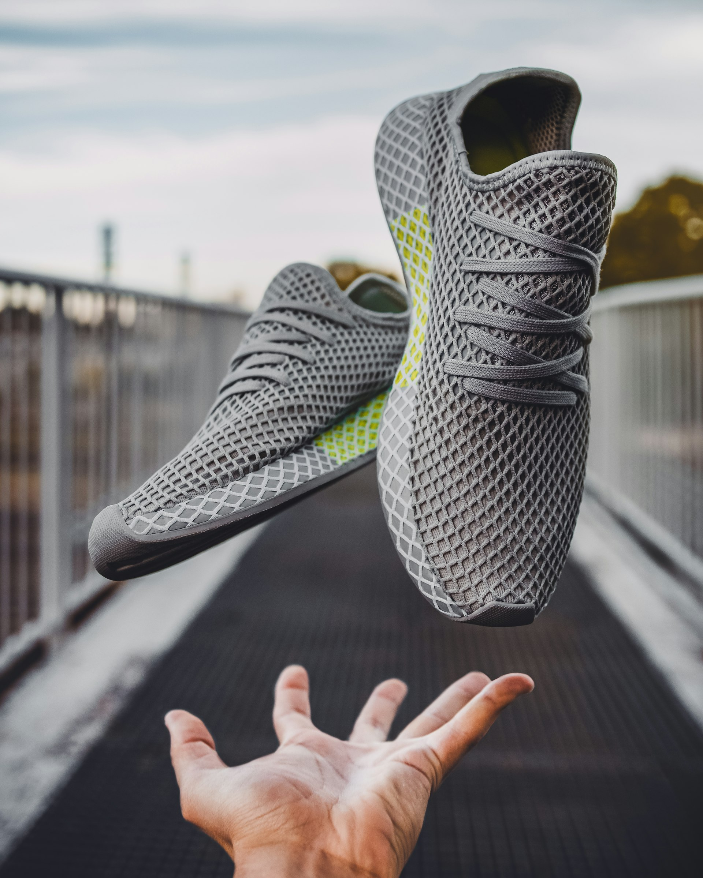
Race Day Protocol · November 1, 2026
MORNING LOGISTICS
- Wake: 5:30 AM
- Pre-race meal by 5:45 AM
- Leave for Grant Park: 6:30 AM
- Corral B check-in: 7:00 AM
- Start gun: 7:30 AM
RACE KIT
- Brooks race day shoes (fresh pair)
- Garmin Forerunner 255
- Bib 4417 pinned race morning
- AirPods Pro — playlist preloaded
FUELING PLAN
- Pre-race: oats and banana at 5:45 AM
- Mile 5: half gel
- Mile 8: full gel + water station
- Mile 11: final gel if needed
EMERGENCY CONTACT
- Naomi Roth: (312) 555-6149
- Will track live from phone
POST-RACE
- Recovery at Cozy Corner
- Celebrate with Naomi
Brooks Glycerin GTS — race day footwear

Slide 7
Everything Points Here.
Lakefront Half-Marathon 2026
Date
Goal
Bib
Club
November 1, 2026
1:42:00
4417
Lakefront Pacers
Chicago Lakefront · November 1, 2026 · Bib 4417
Calvin Maxwell Roth · Lakefront Pacers · Wicker Park, Chicago

